Slide 1

A Hybrid Approach for Real-Time
Parametric Facial Expression Animation
学生：李冰川
导师：姚俊峰
时间：20240109

Slide 2
1
Motivation
2
Method
3
Experiments

Slide 3
1
Motivation

Slide 4
一 Motivation
Notes:
参考：
https://blog.csdn.net/qq_45249273/article/details/127528074?spm=1001.2101.3001.6650.3&utm_medium=distribute.pc_relevant.none-task-blog-2%7Edefault%7ECTRLIST%7ERate-3-127528074-blog-123019675.235%5Ev40%5Epc_relevant_default_base&depth_1-utm_source=distribute.pc_relevant.none-task-blog-2%7Edefault%7ECTRLIST%7ERate-3-127528074-blog-123019675.235%5Ev40%5Epc_relevant_default_base&utm_relevant_index=6

Slide 5
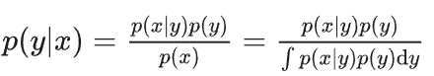
一 Research Background
Variational inference: The so-called variational inference is actually an inference process, that is, using some known statistics to infer other statistics. Within the research scope of variational inference, priors and likelihoods are used to infer posteriors.
Bayesian formula:
Note: p(y|x) represents the posterior, which is what we want to calculate; p(y) represents the prior, which is the original understanding of things; p(x|y) represents the likelihood, which is the exposure to new knowledge (Data): p(z) represents evidence, which is the degree of credibility of this new knowledge. The current situation is that the prior and likelihood are known, and we need to calculate the posterior, but we have difficulty in calculating the evidence.
Our goal is to calculate p(y|x)(the probability of y given x) , and since p(x) is not given directly, we need to replace it in integral form. The problem arises here. This integral is very difficult to calculate, because in practice it is likely to represent the parameters of a neural network, and obviously there is no way to integrate it. Therefore, solving p(y|x) can be transformed into solving p(x|y), and then using q(x|y) to approximate p(x|y) through variation, where y can be regarded as a potential variable z
Notes:
变分推断：
https://zhuanlan.zhihu.com/p/118377754
https://zhuanlan.zhihu.com/p/40105143
https://zhuanlan.zhihu.com/p/445425908

Slide 6
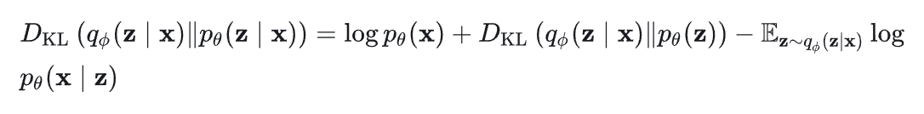
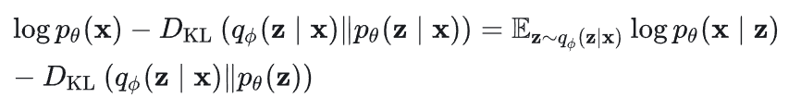
一 Research Background
Variational inference: Variational inference (VI) is a mathematical tool for approximate probability calculations. The basic idea of variational inference is to directly construct an easily observable distribution q(z) and continuously shorten the two distributions distance until convergence. At this time, q(z) can be regarded as an approximation of p(z). Among them, is also called variational distribution (variational distribution)
The right side of the equation is called ELBO, which means evidence lower bound. This is because P_{θ}(x) in the left side of the equation is evidence, and the KL divergence is greater than or equal to 0, so the right side of the equation must be less than evidence and is the lower bound of evidence.

Slide 7
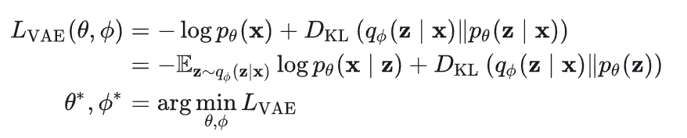
一 Research Background
Variational inference: turning inference into optimization
Our goal is to minimize the second term on the left $DD_{kl}(q_{∅}|p_{θ})$, and p(x) is a fixed value, so it is equivalent to maximizing ELBO.
When we assume that θ is a constant value, variational inference is actually the process of maximizing ELBO. The actual situation is often that we need to optimize θ and ∅ at the same time, such as the variational automatic encoder VAE. At this time, we need to maximize these two parameters at the same time. The corresponding loss function is as follows:
Variational inference uses variational methods to solve problems that cannot be estimated, thereby maximizing or minimizing the desired function.

Slide 8

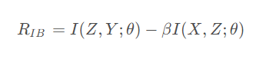
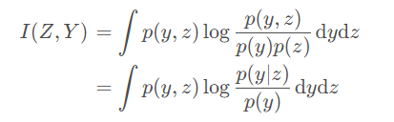
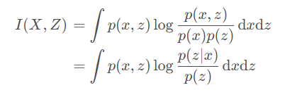
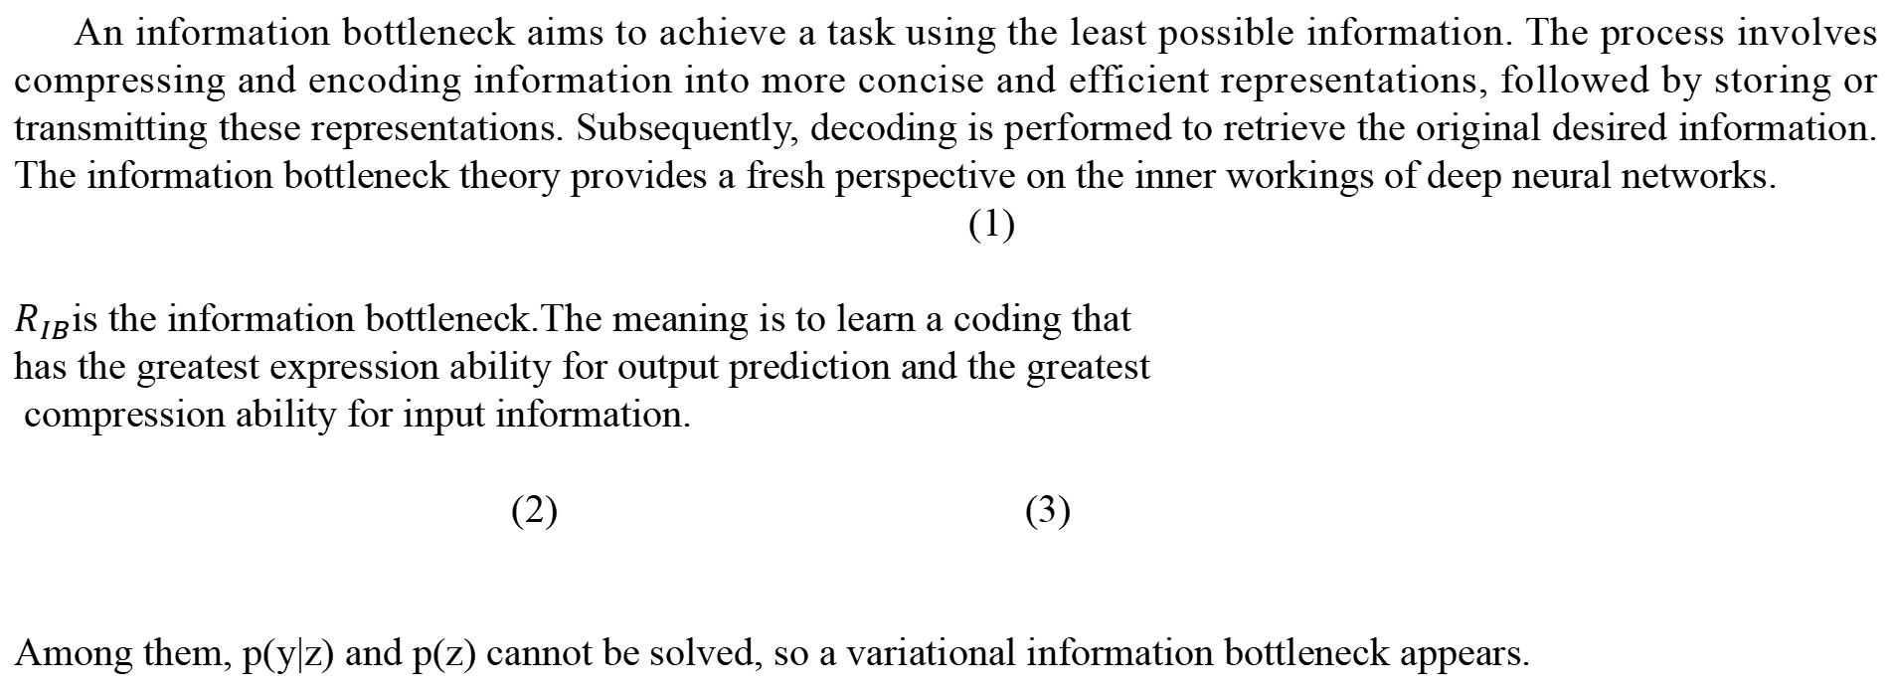
一 Research Background
An information bottleneck aims to achieve a task using the least possible information. The process involves compressing and encoding information into more concise and efficient representations, followed by storing or transmitting these representations. Subsequently, decoding is performed to retrieve the original desired information. The information bottleneck theory provides a fresh perspective on the inner workings of deep neural networks.
(1)
$R_{IB}$is the information bottleneck.The meaning is to learn a coding that
has the greatest expression ability for output prediction and the greatest
compression ability for input information.
(2) (3)
Among them, p(y|z) and p(z) cannot be solved, so a variational information bottleneck appears.
X
T
Y
IB
Notes:
参考：
1. EMNLP 最佳论文解读：来自信息瓶颈的新语言学理论 https://zhuanlan.zhihu.com/p/91383421?utm_id=0

Slide 9
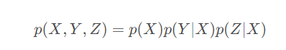
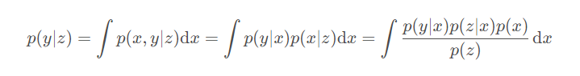
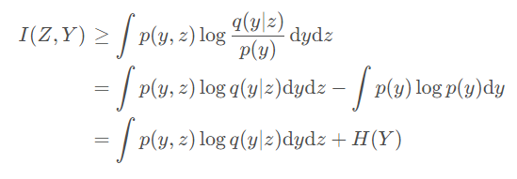
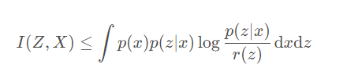
一 Research Background
The Variational Information Bottleneck (VIB) imposes constraints on the mutual information between the internal state of the neural network and the input original data. This effectively controls the accuracy of the neural network task, ensuring that the generated gradient contains more instructive information.
The variational information bottleneck introduces a Markov chain assumption: Y←X<-->Z
where the distribution on this Markov chain can be entirely determined by our encoder p(Z|X) and the constraints of the Markov chain itself. Utilizing the Markov chain, the following formula can be obtained:
where p(z|x) is the encoder, so p(y|z) is completely determined by our encoder and the Markov chain itself.Through variational inference, the upper and lower bounds of the information bottleneck can be inferred to obtain the formula on the left. After optimization, the information bottleneck formula on the right is obtained.
Notes:
参考：
https://blog.csdn.net/qq_45249273/article/details/127528074?spm=1001.2101.3001.6650.3&utm_medium=distribute.pc_relevant.none-task-blog-2%7Edefault%7ECTRLIST%7ERate-3-127528074-blog-123019675.235%5Ev40%5Epc_relevant_default_base&depth_1-utm_source=distribute.pc_relevant.none-task-blog-2%7Edefault%7ECTRLIST%7ERate-3-127528074-blog-123019675.235%5Ev40%5Epc_relevant_default_base&utm_relevant_index=6

Slide 10
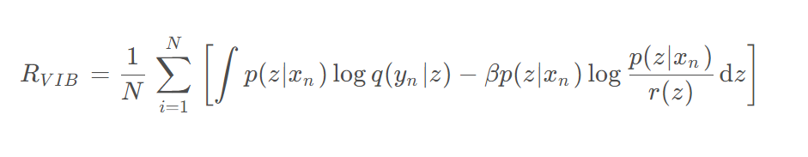
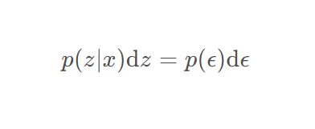
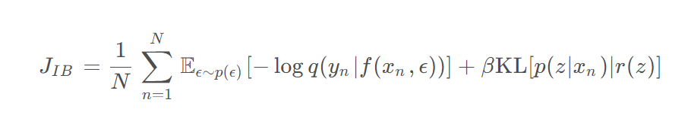
一 Research Background
In actual calculations, by replacing p(x,y) with the empirical distribution $p(x,y)=\frac{1}{N}\sum_{i=1}^{N}{δ_{x_{n}}}(x)δ_{y_{n}}(y)$, the optimization formula of the variational information bottleneck can be obtained.
Assume that the encoder is a VAE-like structure, $p(z|x)=Ν(z|f_{e}^{μ}(x),f_{e}^{Σ}(x))$ is a Gaussian distribution, and reparameterization techniques can be used.
Assume that the selection of p(z|x) and r(z) enables us to calculate the KL divergence, so, Maximizing the variational information bottleneck can be transformed into minimizing the following goals in actual calculations:
Notes:
参考：
https://blog.csdn.net/qq_45249273/article/details/127528074?spm=1001.2101.3001.6650.3&utm_medium=distribute.pc_relevant.none-task-blog-2%7Edefault%7ECTRLIST%7ERate-3-127528074-blog-123019675.235%5Ev40%5Epc_relevant_default_base&depth_1-utm_source=distribute.pc_relevant.none-task-blog-2%7Edefault%7ECTRLIST%7ERate-3-127528074-blog-123019675.235%5Ev40%5Epc_relevant_default_base&utm_relevant_index=6

Slide 11
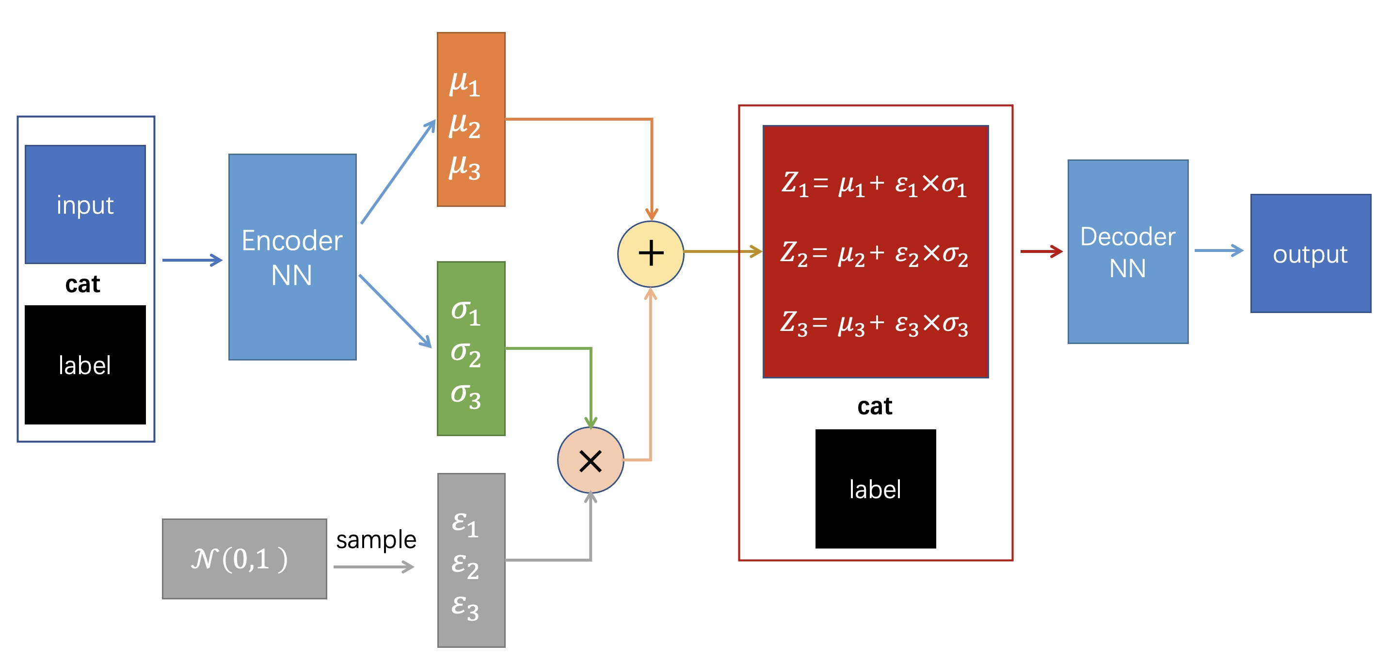
一 Research Background
Variational Information Bottleneck(VIB)
The main changes to the variational information bottleneck are:
1. Introduced the concepts of mean and variance, and added reparameterization trick
2. Added KL divergence as an additional loss function
Notes:
参考：
https://blog.csdn.net/qq_45249273/article/details/127528074?spm=1001.2101.3001.6650.3&utm_medium=distribute.pc_relevant.none-task-blog-2%7Edefault%7ECTRLIST%7ERate-3-127528074-blog-123019675.235%5Ev40%5Epc_relevant_default_base&depth_1-utm_source=distribute.pc_relevant.none-task-blog-2%7Edefault%7ECTRLIST%7ERate-3-127528074-blog-123019675.235%5Ev40%5Epc_relevant_default_base&utm_relevant_index=6

Slide 12
2
Research Content

Slide 13
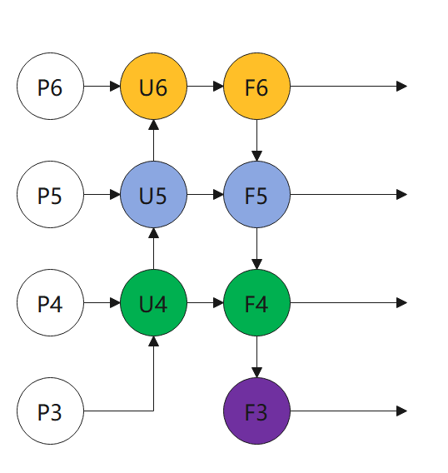
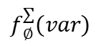
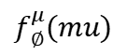

二 Research Content
This report is about Multiscale Framework Based on Variational Information Bottleneck
The research content of this article is mainly to explore how to optimize multi-scale information and find a method to fully extract multi-scale information, so as to maximize information extraction and maximize information bottlenecks. The following is his architecture diagram:
mu
var
sample
Y
$$f_{∅}^{μ}(mu)$$
$$f_{∅}^{∑}(var)$$
$$ε∈𝒩(0,1)$$

Slide 14
二 Research Content
This research aims to find an efficient method to maximize and optimize information extraction.
By employing variational inference methods, we delve into strategies for maximizing information bottlenecks in the framework.
Through variational inference, we propose an innovative framework that demonstrates the potential of maximizing information bottlenecks under different data levels.
After processing through the following variational method, the information bottleneck can be maximized in the framework.
The research method in this article can achieve the maximum and ultimate optimization of information extraction. After variational processing, the information bottleneck in the framework can be maximized.
1. In order to maximize the information bottleneck, it is necessary to ensure that p(z|x), p(z), p(x|z) is Gaussian distribution, use KL divergence for constraints
2. In order to make p(z|x) is Gaussian, KL divergence is used to constrain N(0,1).
3. p(z) is Gaussianized using resampling
4. The Gaussianization of p(x|z) is constrained by cross-entropy.
Purpose
Specific Goals
Method
Innovation
Notes:
This research aims to find an efficient method to maximize and optimize information extraction. By employing variational inference methods, we delve into strategies for maximizing information bottlenecks in the framework. The core goal of the research is to achieve the maximum effect of information extraction through optimization methods at different data levels. This includes an in-depth exploration of information bottlenecks and the search for adequate extraction strategies to ensure optimal information delivery in environments with different data levels. Through variational inference, we propose an innovative framework that demonstrates the potential of maximizing information bottlenecks under different data levels.
After processing through the following variational method, the information bottleneck can be maximized in the framework.
1. In order to maximize the information bottleneck, it is necessary to ensure that p(z|x), p(z), p(x|z) Gaussian distribution, use KL divergence for constraints
2. In order to make p(z|x) Gaussian, KL divergence is used to constrain N(0,1).
3. p(z) is Gaussianized using resampling
4. The Gaussianization of p(x|z) is constrained by cross-entropy.
本研究旨在寻找一种高效的方法，以实现信息提取的最大化和极致优化。通过采用变分推断方法，我们深入研究了信息瓶颈在框架中的最大化策略。研究的核心目标是在不同数据层次上通过优化方法，达到信息提取的最大效果。这包括对信息瓶颈的深入探讨，寻找充分的提取策略，以确保在不同数据层次的环境中实现信息传递的最佳效果。通过变分推断，我们提出了一种创新的框架，展现了在不同数据层次下最大化信息瓶颈的潜力。
通过如下变分方法进行处理后，可以获得信息瓶颈在框架中的最大化。
1.为了信息瓶颈的最大化，需要保证p(z|x)，p(z),p(x|z)高斯分布，采用KL散度，进行约束
2. 为了使得p(z|x)高斯化，采用KL散度对N(0,1)进行约束。
3. p(z)采用重采样进行高斯化
4. p(x|z)高斯化通过交叉熵进行约束。

Slide 15
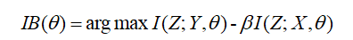
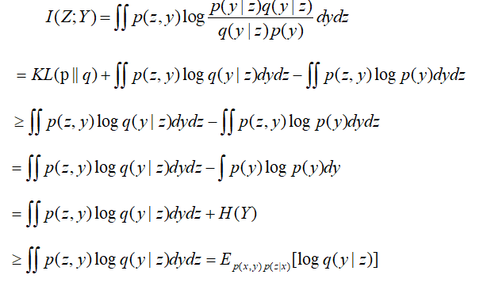
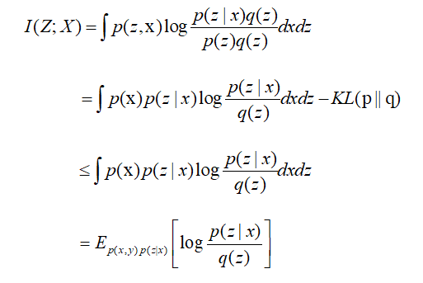
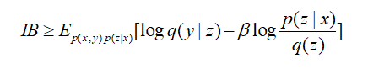
二 Research Content
From the previous introduction, we can know that information bottleneck is a theory that weighs the mutual information between feature Z, label information Y and input information X.
Therefore, in order to maximize the information bottleneck IB, a variational q(z) is used to approximate the feature layer p(z), as shown in the following formula:
At the same time, in order to maximize the information bottleneck IB, it is to maximize the mutual information I(Z;Y) and maximize the mutual information -I(Z;X). The mutual information I(Z;Y) can be derived as follows:
The combination of the two formulas on the left forms a lower bound for the information bottleneck. The deep learning network only needs to optimize this lower bound.

Slide 16
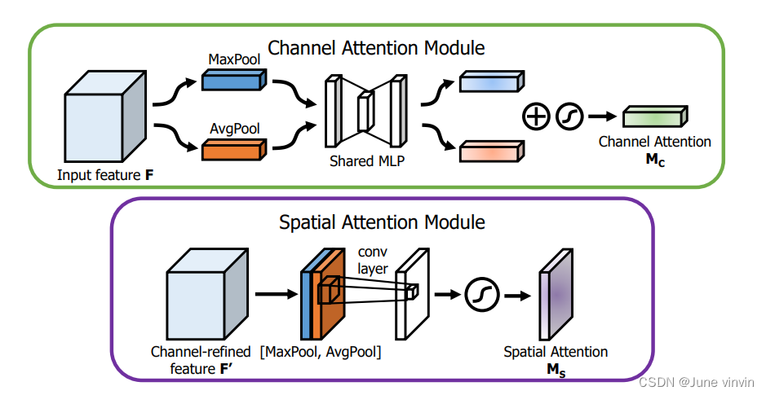
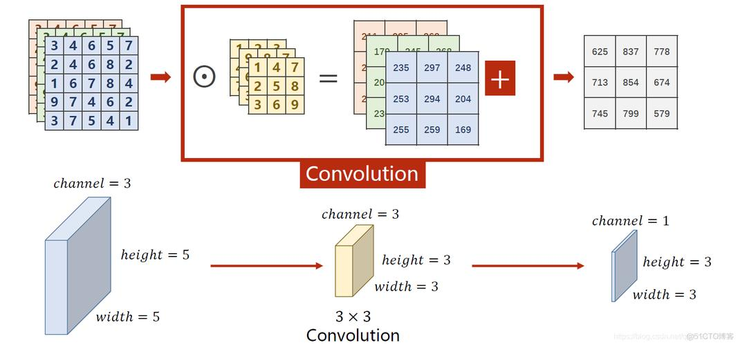
二 Research Content
In addition, we also explored the impact of the attention mechanism on multi-scale information and studied the maximum optimization value of the attention mechanism on information bottlenecks.

Slide 17
3
Exploration of Doctoral Topics

Slide 18
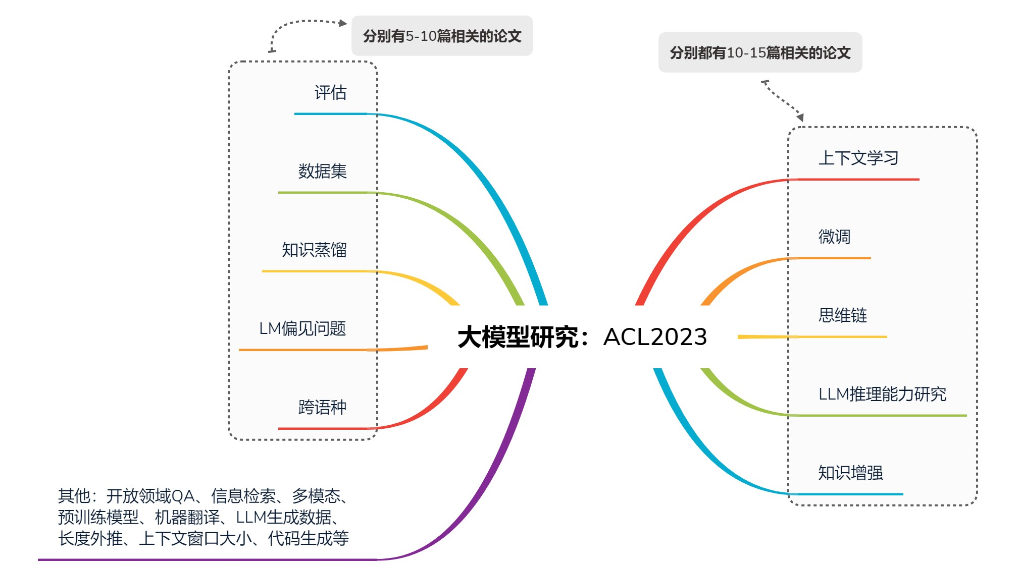
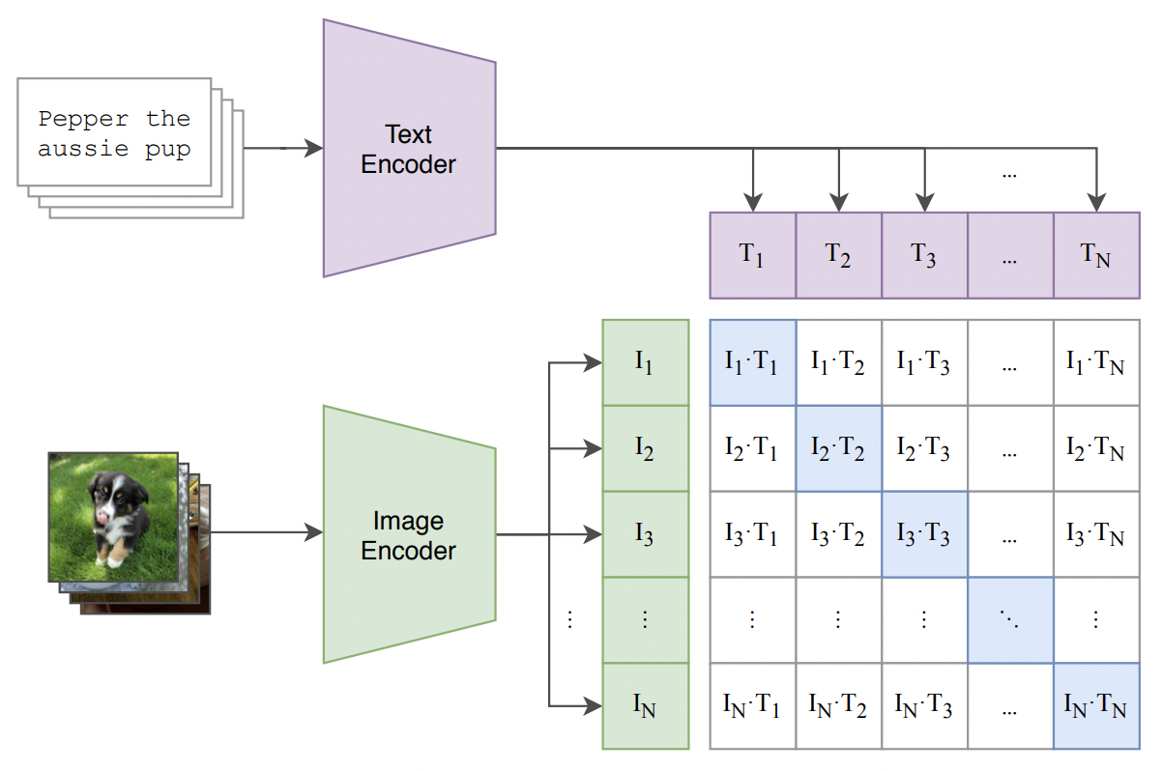
三 Exploration of Doctoral Topics
Research Progress on the Doctoral Thesis Topic: Analyzed the research advancements in various fields involving large models in 2023. Additionally, investigated the correlation between large models and multimodal content.

Slide 19
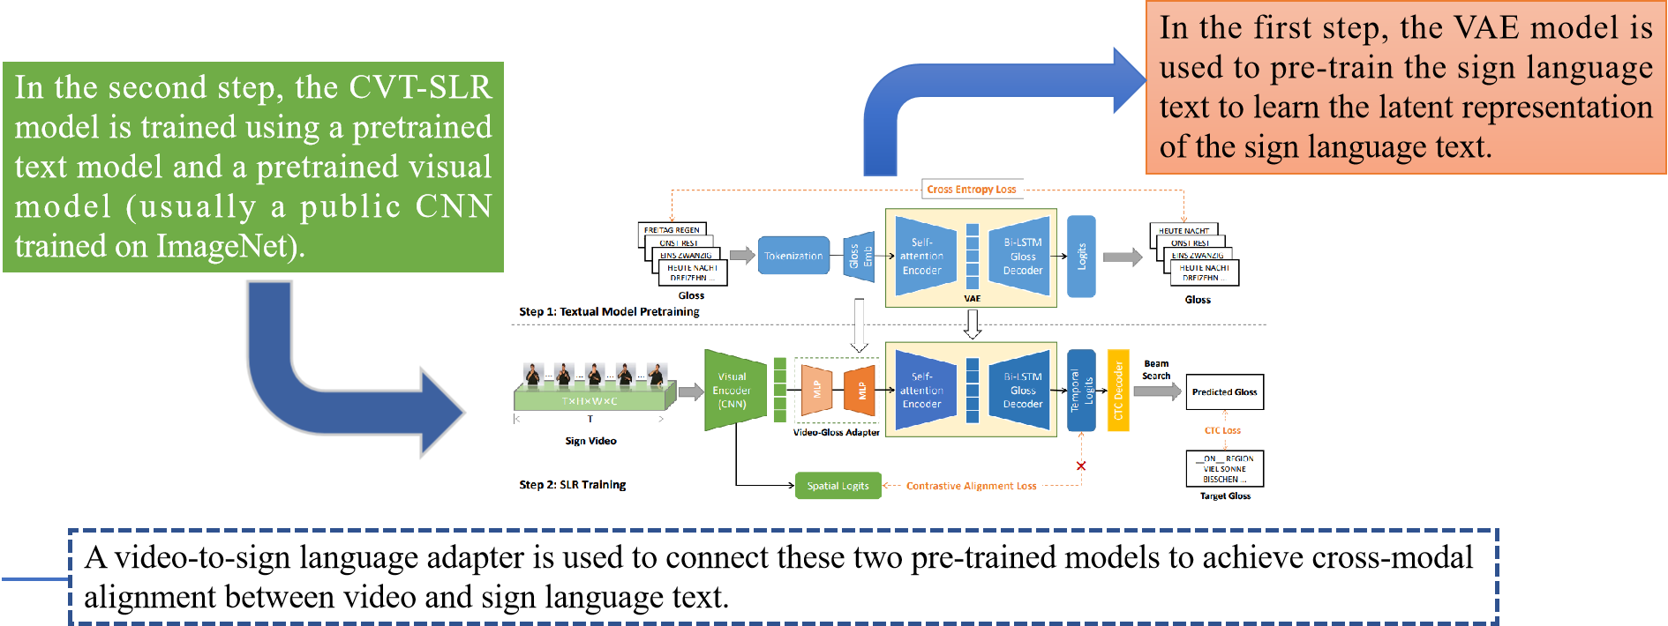
三 Exploration of Doctoral Topics
In addition, we also studied multi-modal and variation-related content. The CVT-SLR is a framework for aligning vision and text, and uses VAE for alignment.
CVT-SLR: Contrastive Visual-Textual Transformation for Sign LanguageRecognition with Variational Alignment
Notes:
基于单线索跨模态对齐框架，CVT-SLR保留了预训练的视觉模块，但用一个VAE取代了传统的上下文模块。由于使用了完整的编码器-解码器架构，自编码器的形式中VAE保持了输入和输出模式的一致性，起到了隐性的跨模态对齐作用。引入了一种对比对齐算法，该算法专注于正反两方面的样本，以加强显式的跨模态一致性约束。

Slide 20
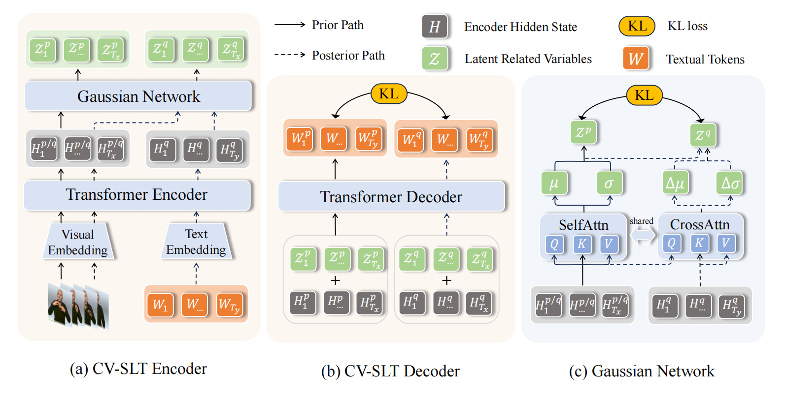
三 Exploration of Doctoral Topics
CV-SLT is also a framework that aligns vision and text, converting continuous sign language videos into textual sentences. It introduces a hand sign translation framework based on a conditional variational autoencoder (CV-SLT), facilitating direct and comprehensive cross-modal alignment between sign language videos and spoken language text.
Conditional Variational Autoencoder for Sign Language Translation with Cross-Modal Alignment
Notes:
CV-SLT包含两个路径，有两个Kullback-Leibler（KL）散度来规范编码器和解码器的输出。
在先验路径中，模型仅依赖于视觉信息来预测目标文本；
在后验路径中，它同时编码视觉信息和文本知识以重构目标文本。
----------------------
第一个KL散度优化条件变分自动编码器并规范编码器的输出，而第二个KL散度从后验路径到先验路径执行自我蒸馏，确保解码器输出的一致性。
------------------
主要贡献：
• 我们提出了CV-SLT，它包含两个路径和两个Kullback-Leibler（KL）散度，旨在缓解手语翻译中的模态差距。
• 共享的注意力高斯残差分布（ARGD）进一步增强了文本信息对后验路径的整合。

Slide 21
谢谢大家宝贵时间
欢迎大家批评指正
THANKS

